Slide 1
Designing Mobile Clinical Decision Support Systems: Lessons from the CLOTS Study
Nalika Ulapane¹, Nilmini Wickramasinghe¹, and Kate Burbury²
¹ Swinburne University of Technology
² Peter MacCallum Cancer Centre
Correspondence: nilmini.work@gmail.com or nwickramasinghe@swin.edu.au
A project funded by the Digital Health CRC (DHCRC-0055), Peter MacCallum Cancer Centre, and Swinburne University of Technology
ACIS 2022 | 4-7 December, 2022 | Melbourne

Slide 2
Agenda
Motivation (& Background)
Healthcare Focus
Our Intervention & Impact: The CLOTS App
Our Work
Current Developments
Concluding Remarks & Future Work
Slide 1 of 14

Slide 3
Motivation
Opportunities &
Enablers
Barriers or Challenges
Ethics
IoT
Legislative
Policy
AI
ML
Security
Economy
mHealth
Effectiveness
eHealth
Accountability
Telehealth
Workflow
Process
Industry 4.0
Culture
People
Uptake
Healthcare 4.0
Change-Management
Slide 2 of 14

Slide 4
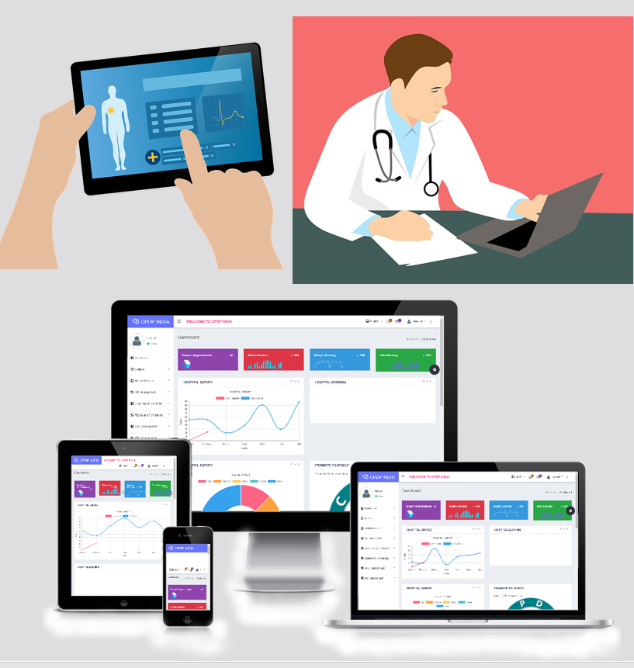
Research Question
Attempt to answer the question: How to design mobile CDSSs having superior fit-for-purpose?
Mobile Clinical Decision Support Systems (CDSSs)
Healthcare Setting (Perioperative Patient Management, Thromboembolism-related)
Slide 3 of 14

Slide 5
Theoretical Grounding
- Decision Making (Simon, 1997) - Clinical Decision Making (Edwards, et., al., 2004)
Decision Making &
Clinical Decision Making
- Inquiring Systems (Churchman, 1971) - Decision Support Systems (Churchman, 1971) - Clinical Decision Support Systems (Wasylewicz, et., al., 2019) - Intelligent Clinical Decision Support Systems (Ciolko, et., al., 2010)
Decision Support Systems & CDSSs
- Critical issues in mobile CDSSs (Ulapane & Wickramasinghe, 2021)
Issues with mobile CDSSs
Slide 4 of 14

Slide 6
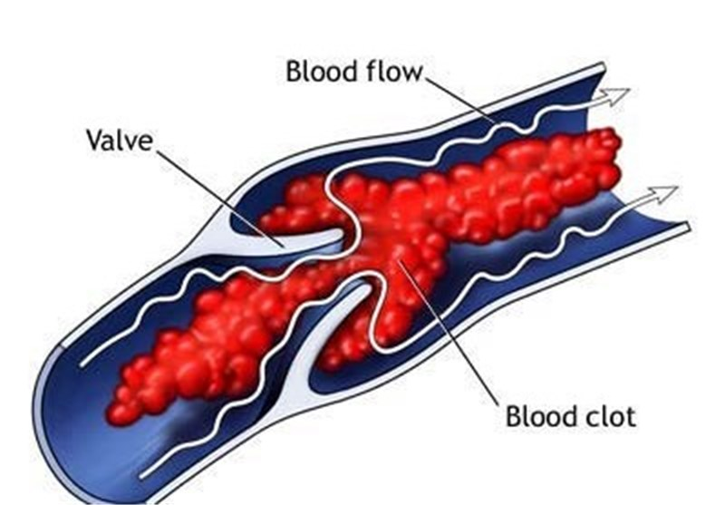
Healthcare Focus (Background)
Thromboembolism is the formation of blood clots in veins located deep inside the body
2–13 in every 1000 elective surgical admissions in Australia develop a symptomatic postoperative venous thromboembolism (VTE) (Chahal, et. al., 2020)
Results in a 10% case fatality rate (Chahal, et. al., 2020)
This Photo by Unknown Author is licensed under CC BY
Slide 5 of 14

Slide 7
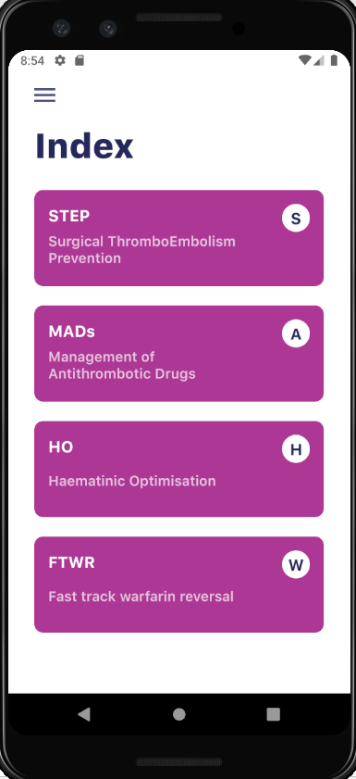
Our Intervention & Impact: The CLOTS App
CLOTS App: A point of care decision support tool for clinicians surrounding perioperative patient management
Surgical Thromboembolism Risk Calculator
Haematinic Optimization
Antithrombotic Drug Management
Fast Track Warfarin Reversal
Impact: Has influenced a 79% or relative risk reduction in VTE events in a leading Australian Cancer hospital (Chahal, et. al., 2020)
Slide 6 of 14

Slide 8
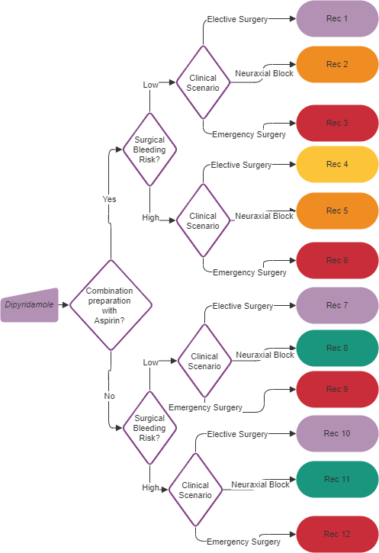
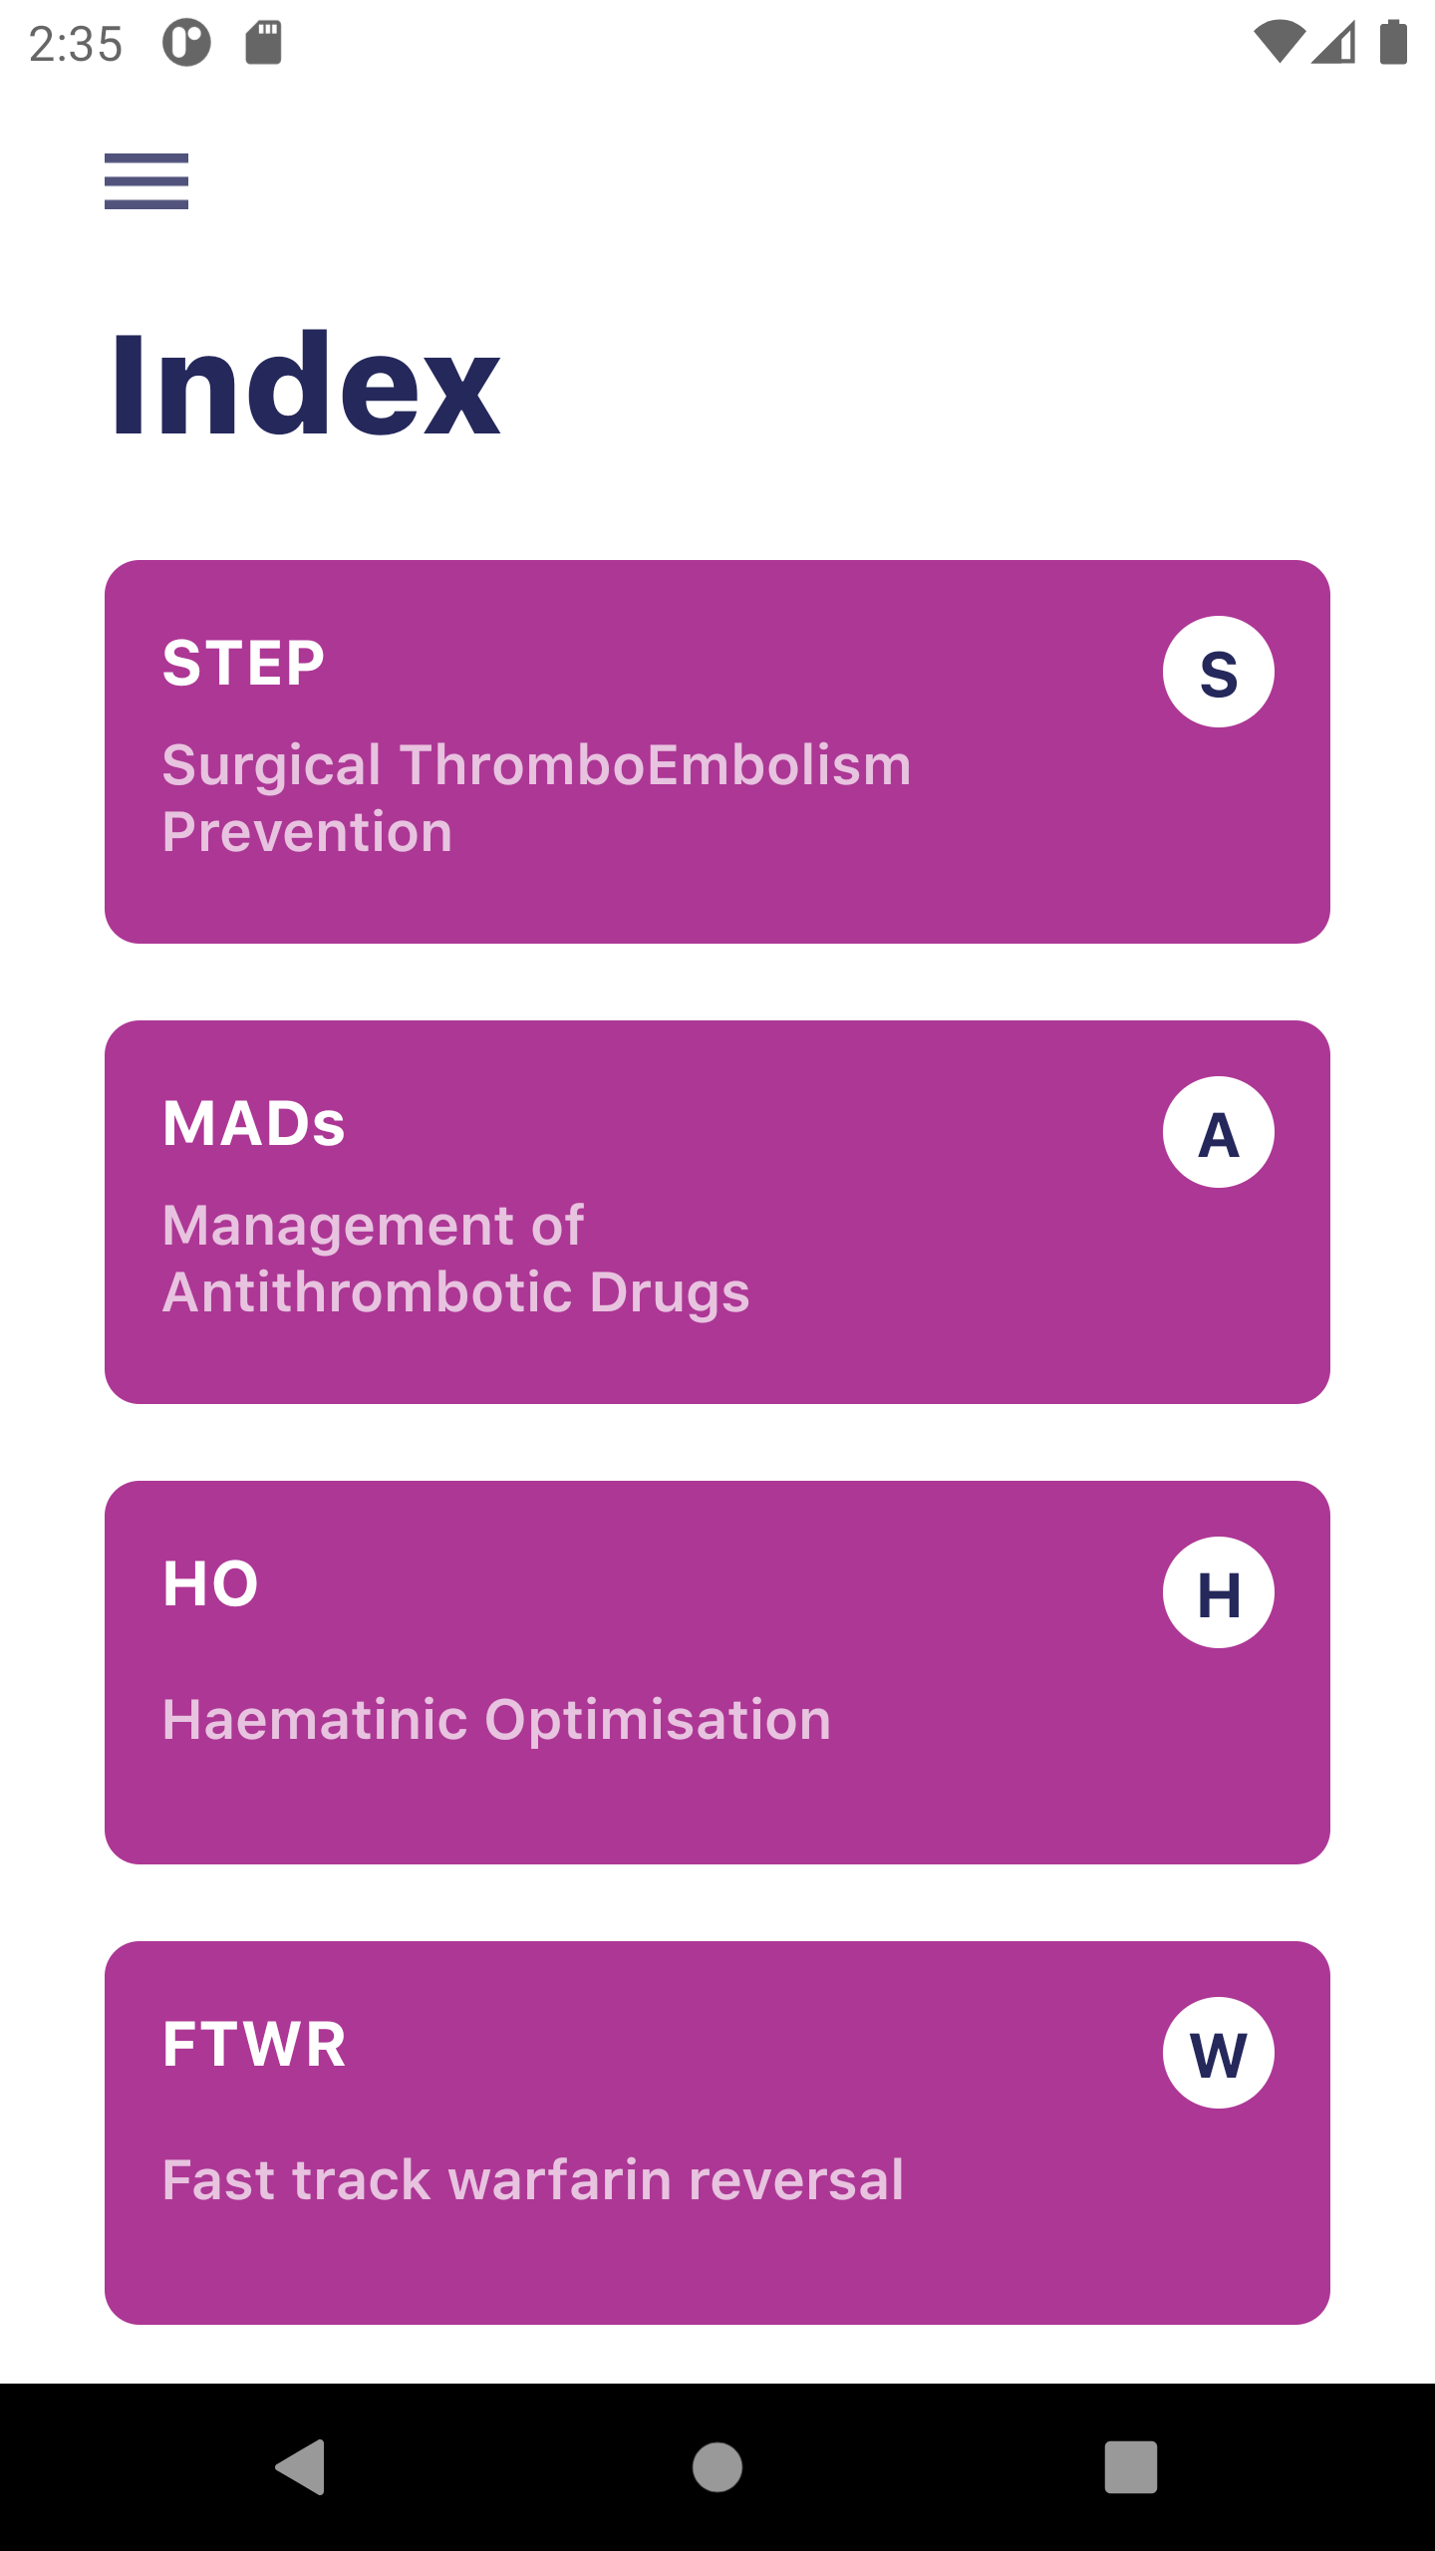
Our Intervention: The CLOTS App
CLOTS App: Operates based on decision flowcharts
Slide 7 of 14

Slide 9
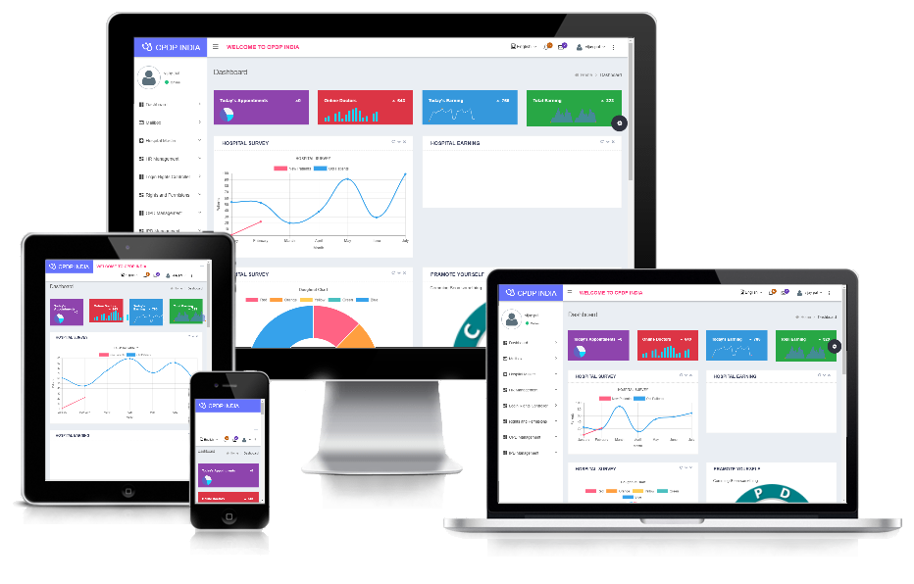
Our Workflow
Codesign Phase 1:
Commercialization Phase:
Knowledge from Literature
Clinicians’ Perspectives
Software redevelopment
Scalable
Expandable
Interoperable
Standardize
TGA Approval
CLOTS App Version 1
Point of Care CDSS
No Back End
CLOTS App Version 2
Point of Care CDSS Plus
Back End and Analytics
Start of project
2020 Jan
Present
2022 Oct
Timeline
Slide 8 of 14

Slide 10
The CLOTS App
The redesigned CLOTS App
Video Demo: https://dit.swin.edu.au/clotsapp/CLOTS_demo.mp4
Slide 9 of 14

Slide 11
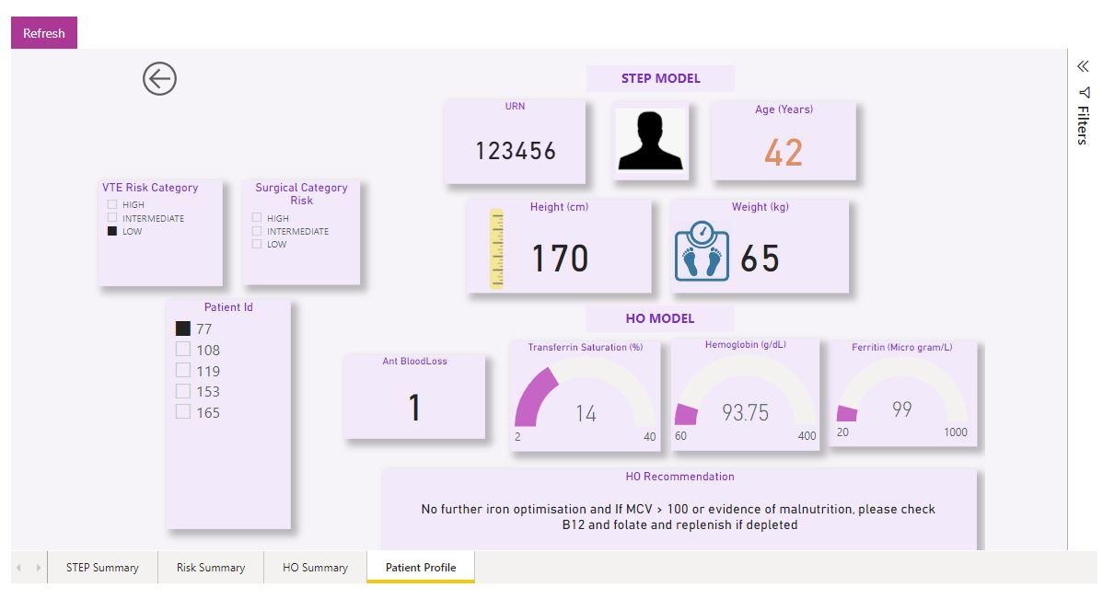
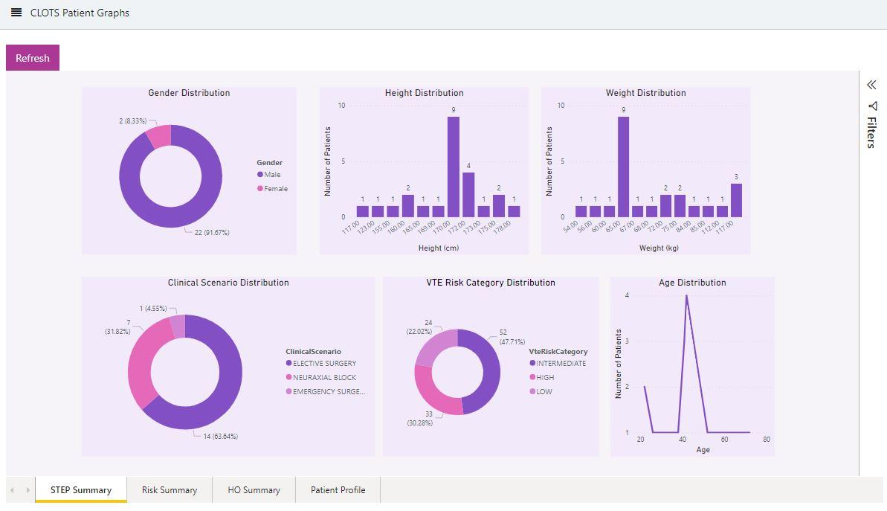
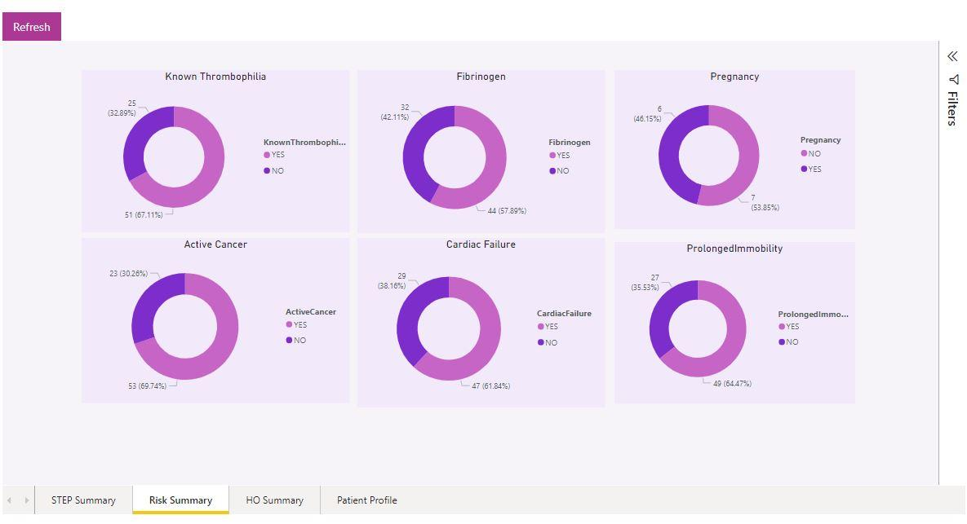
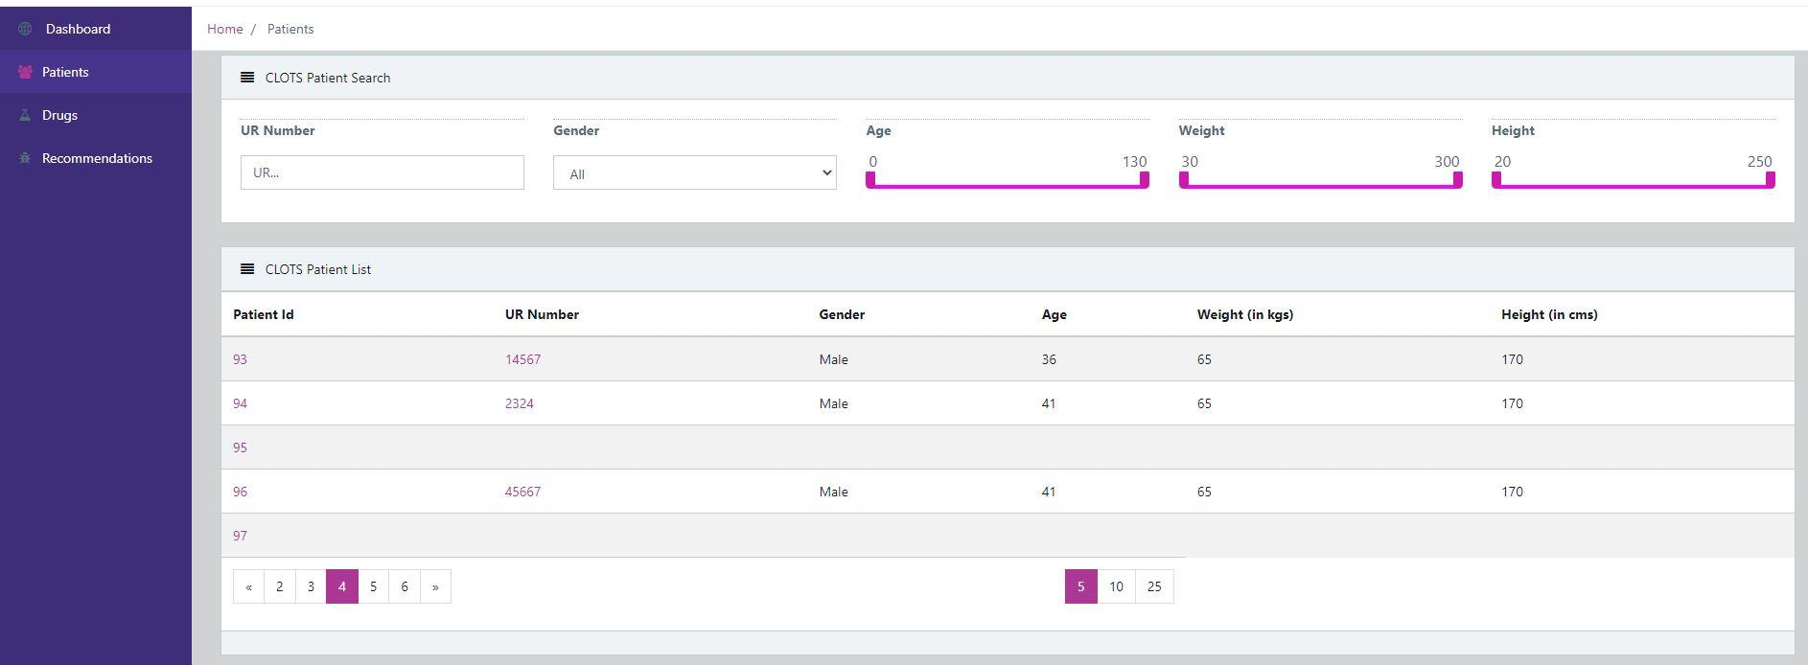
Dashboard Analytics from CLOTS
Analytics Display Dashboard
Individual Patient Profile
Individual Patient Profile
Patient Register
Cohort Analytics
Patient Register
Cohort Analytics
Slide 10 of 14

Slide 12
Results from Post User-Testing
Clinicians Perspectives on Features of CLOTS App
Method of Assessment
- Multiple focus groups, interviews, and surveys
- Theoretical grounding for assessment: Theories of Task Technology Fit and Fit-Viability
- Number of participants: 12
- Participants include: Haematologists, Anaesthetists, Nurses, and Junior Doctors
This Photo by Unknown Author is licensed under CC BY-SA-NC
Slide 11 of 14

Slide 13
Results from Post User-Testing
Clinicians Perspectives on Features of CLOTS App
Clinicians’ Task Characteristics
- Frequency of use varies among users (almost never to a several times a week)
- Senior and Junior clinicians tend to use it differently
- Purpose of use, helps to refresh memory, as well as an educational tool
Clinicians’ Satisfaction on Technology Characteristics
- Consensus (100% of participants) for users being satisfied
- Some concern (~10% of participants) about Data accuracy and Data currency (i.e., how up to date the data is)
- Junior clinicians would like more references to be cited within the App
Impact on Clinicians’ Performance
- Consensus (100% of participants) on CLOTS having a significant Impact on performance (patient outcomes, ease of task, accuracy of task, saving time)
Slide 12 of 14

Slide 14
Discussion
Implications to Theory
- Sets foundation for a rubric to guide the design, development, and assessment of mobile CDSSs
Implications to Practice
- Develops and validates a mobile CDSS to assist in perioperative patient management
Limitations & Challenges
- A project conducted during the COVID-19 pandemic
- Recruiting participants, finding time has been challenging
Lessons & Reflections
- Interoperability with existing hospital systems can be somewhat challenging
- Policy and strategy relating to software integration and access to data whilst enhancing security might need rethinking
Slide 13 of 14

Slide 15
Concluding Remarks
- A mobile CDSS prototype has been built, tested and validated
- Digital health solutions require commercialization to be beneficial to the public
- Currently working with a tech company regarding commercialization
- A commercialization pipeline that has been suggested for CLOTS:
Slide 14 of 14

Slide 16
Designing Mobile Clinical Decision Support Systems: Lessons from the CLOTS Study
Nalika Ulapane¹, Nilmini Wickramasinghe¹, and Kate Burbury²
Acknowledgment: An outcome from the DHCRC-055 project funded by the Digital Health CRC Limited, the Peter MacCallum Cancer Centre, and the Swinburne University of Technology, Australia. Digital Health CRC Limited is funded under the Commonwealth Government’s Cooperative Research Centres Program.
¹ Swinburne University of Technology
² Peter MacCallum Cancer Centre
Correspondence: nilmini.work@gmail.com or nwickramasinghe@swin.edu.au
Thank You
ACIS 2022 | 4-7 December, 2022 | Melbourne

